Slide 1



Data Science
Foundations
Master in Big Data Solutions 2017-2018
Francisco Gutierres
francisco.gutierres@bts.tech
Ludovico Boratto
ludovico.boratto@bts.tech
Liana Napalkova
liana.napalkova@bts.tech
Barcelona Technology School S.L.

Slide 2
Session 9 – Continuous distributions (Data Exploration and Imputation) & Introduction to GIS Science
Francisco Gutierres

Slide 3

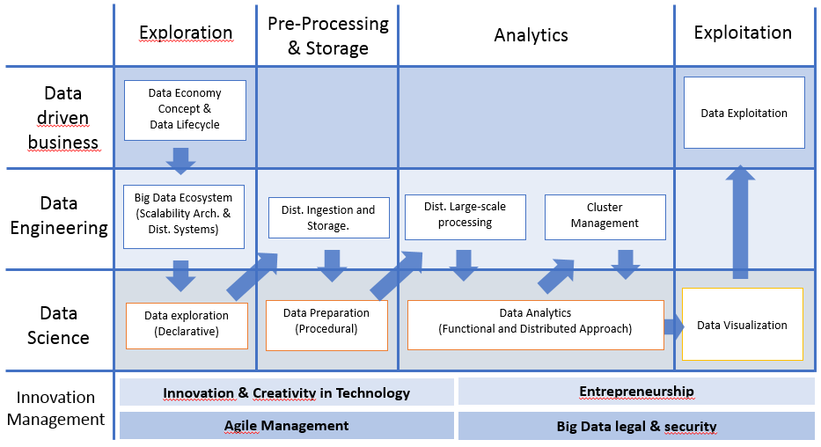
What we will learn
Session9:
Continuous distributions (Data Exploration and Imputation) & Introduction to GIS Science
- Continuous distributions (Data Exploration and Imputation) using Pandas, Numpy, and Matplotlib libraries.
- Introduction to GIS Science.
We will learn how to:
Implement of several Phyton libraries (Pandas, Numpy and Matplotlib) to perform Data Exploration and Imputation using DataFrames.
Introduction to GIS concepts, file types and ArcGIS Online plataform.

Slide 4
Today’s Objective
What will we learn today?
How to perform data imputation.
GIS concepts and frameworks.

Slide 5
Continuous distributions (Data Exploration and Imputation)

Slide 6

Contents
I. Activities in the class (Demos - Data imputation)
II. Exercise
Use a Pandas DataFrame “Bike sharing” :
Perform the imputation for the variable “temp”.
Commit scripts to your Git.
Create your repository “DataScienceFoundations”.

Slide 7
Demo of Data Imputation

Slide 8
Demo 1
Objective: Mastering skills about Data exploration and Imputation.
Phyton libraries for Descriptive Statistics: Pandas, numpy and Matplotlib.
Create a new notebook and put your code in the final.
Export your Demo 1 *.ipynb notebook and push it to your repository “DataScienceFoundations”.

Slide 9
Class Exercice
of Data Imputation

Slide 10
Exercise 1
Exercise 1 – Data Imputation
Considering the dataset “Bike sharing” develop the imputation for the variable “temp”.
Interpret and discuss the Results.
Commit scripts in your GitHub account. You should export your solution code (.ipynb notebook) and push it to your repository “DataScienceFoundations”.
The following are the tasks that should complete and synchronize with your repository “DataScienceFoundations” until November 14. Please notice that none of these tasks is graded, however it’s important that you correctly understand and complete them in order to be sure that you won’t have problems with further assignments.
Guidelines:
Clone the Git repository to get an initial code:
https://github.com/FGutierresBTS/BTS_MasterInBigData.git
Once you downloaded the repository to your local file system, go to the folder “BTS_MasterInBigData/Session_9_DSF”.
Copy the folder “Session_9_DSF” into your local folder “DataScienceFoundations”.
In the folder “Session_9_DSF” you will see the files called:
- BTS_DataScienceFoundation_Session9_DataExploration_Imputation_Exercise1.ipynb
Import these files into Jupyter Notebook using the “Upload” button.
Open the imported script and put your code inside the notebook.
Export your Exercise1 *.ipynb notebook and push it to your repository “DataScienceFoundations”. Also in “Teams/Assignments” section.

Slide 11
Introduction to GIS Science

Slide 12
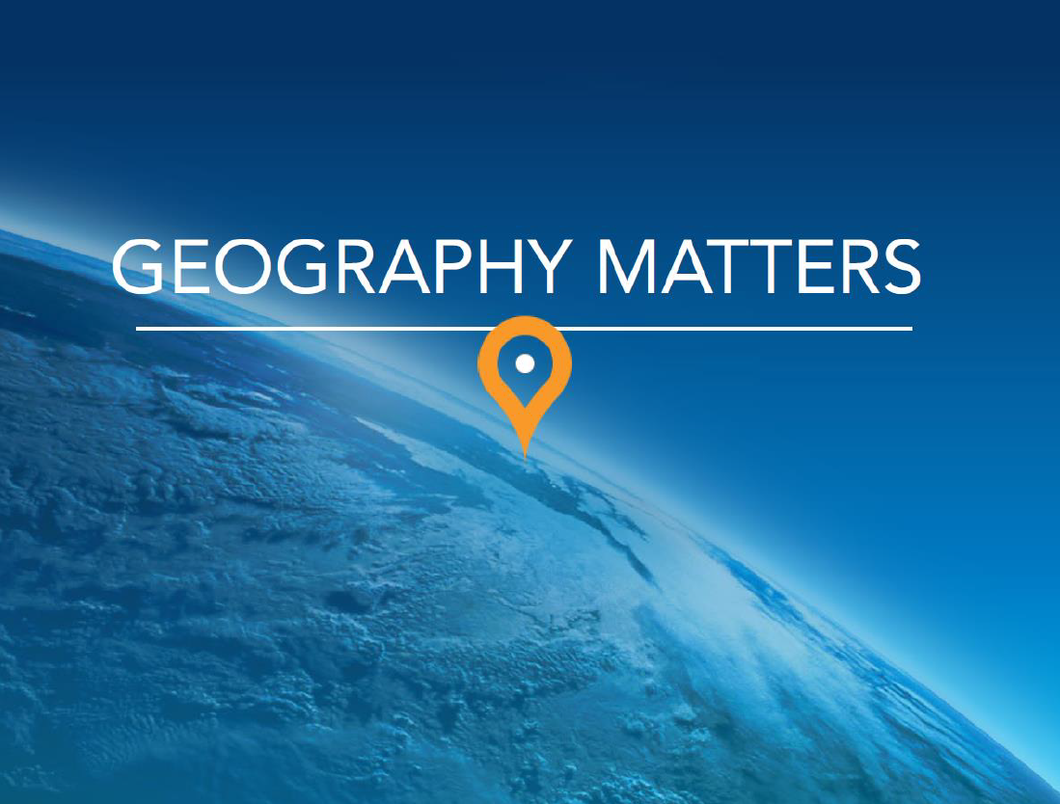

Slide 13
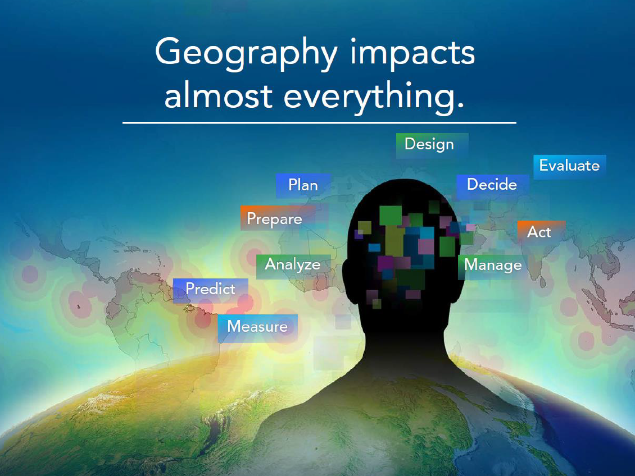

Slide 14
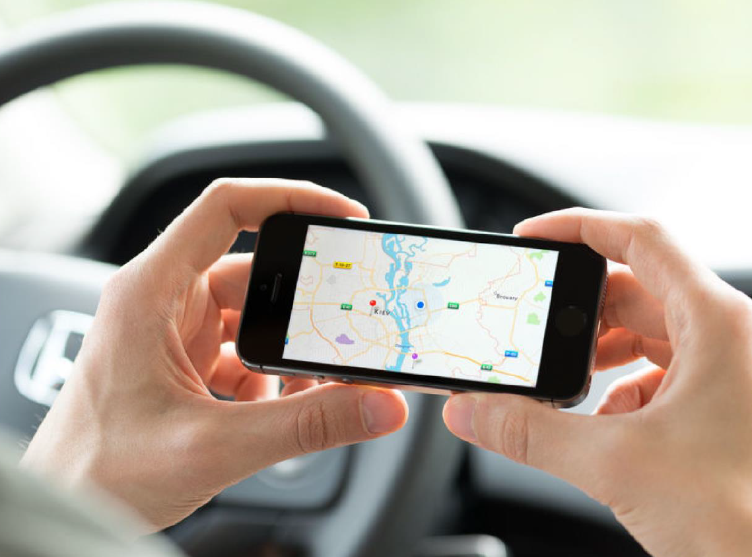

Slide 15
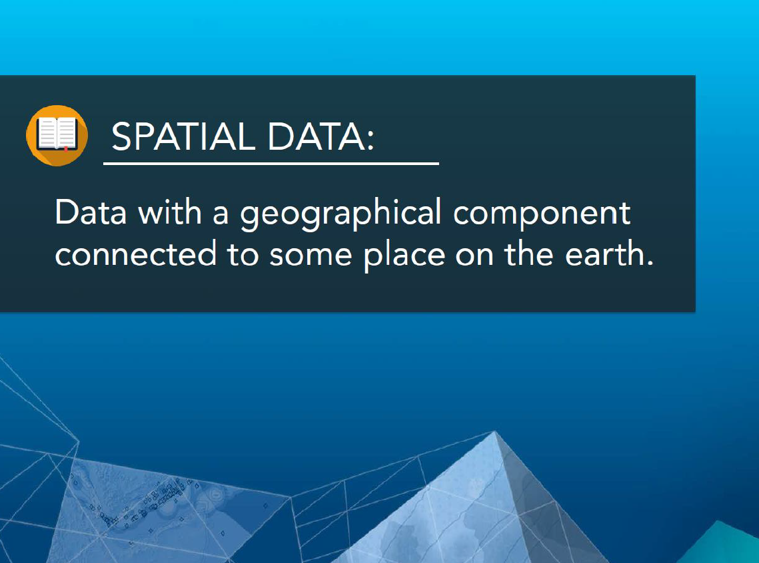

Slide 16
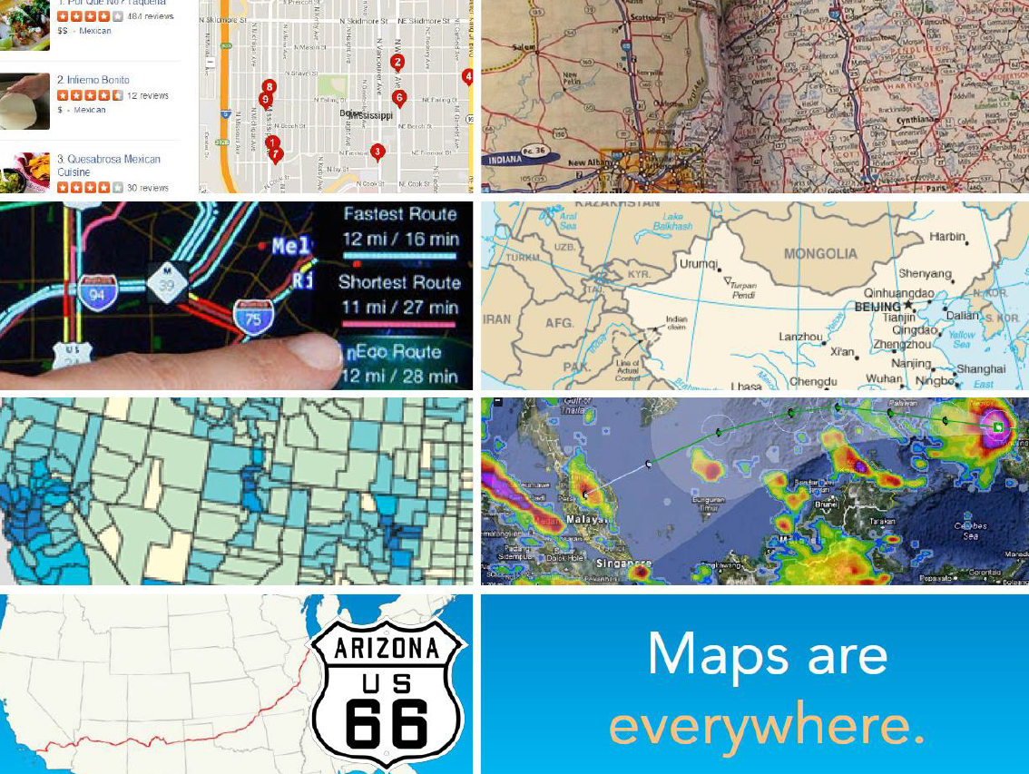

Slide 17
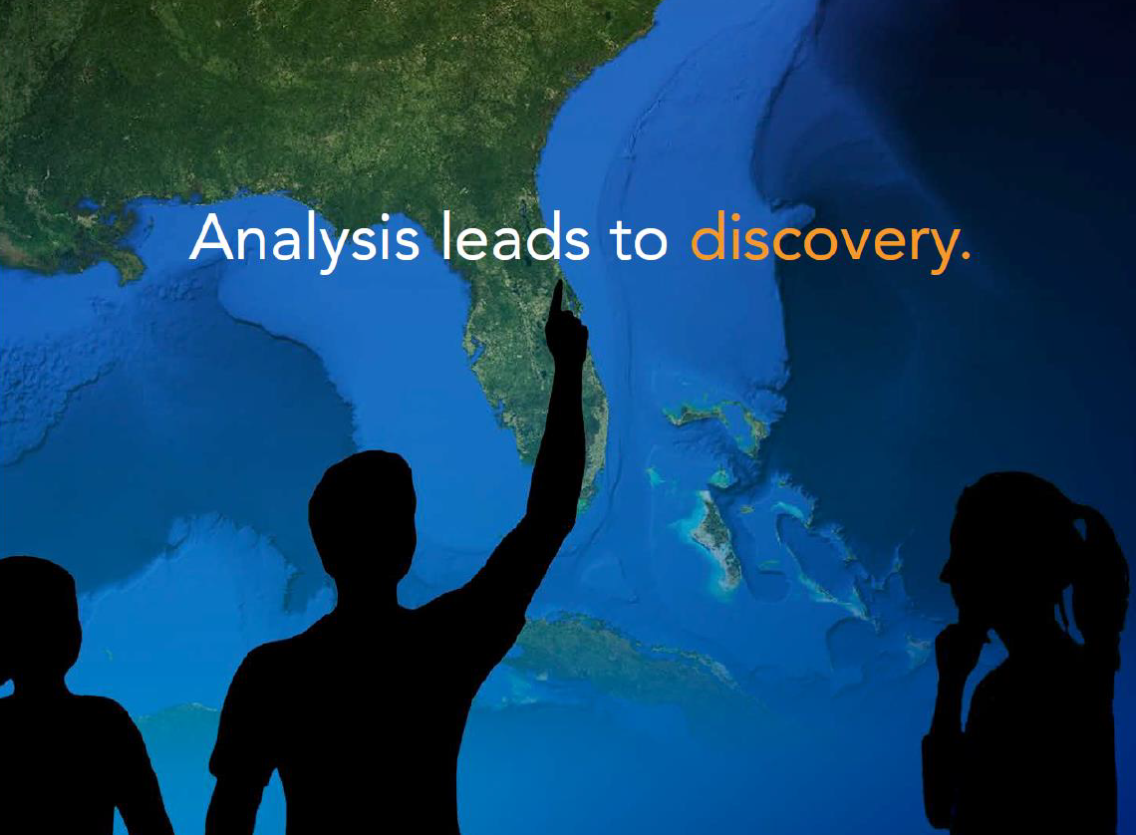

Slide 18
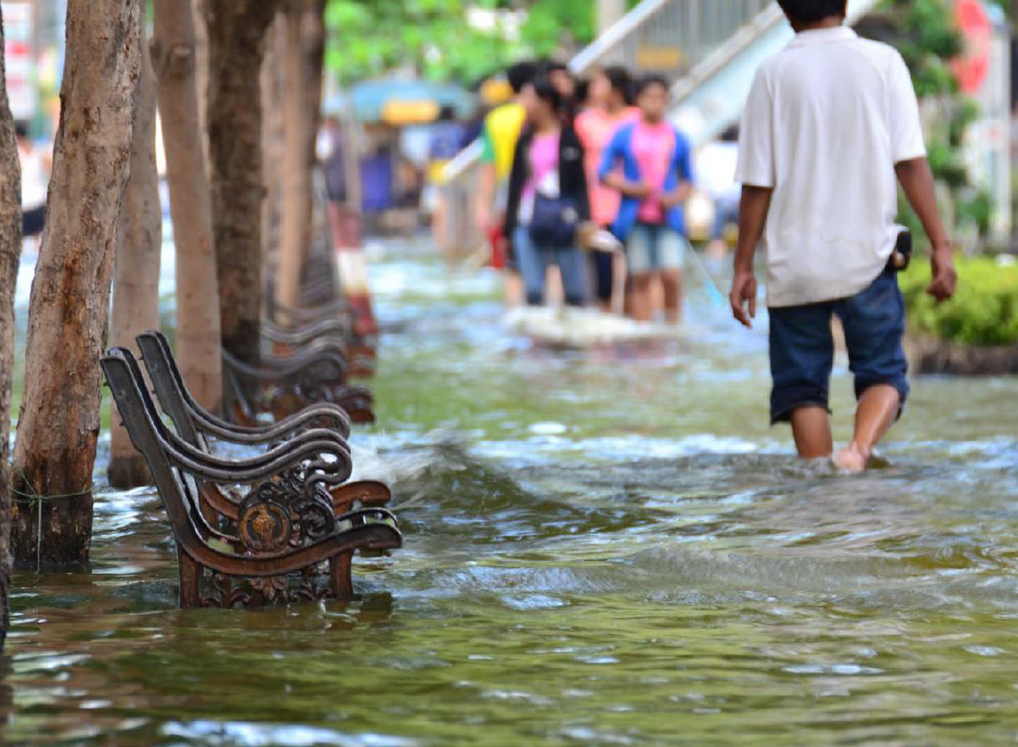

Slide 19
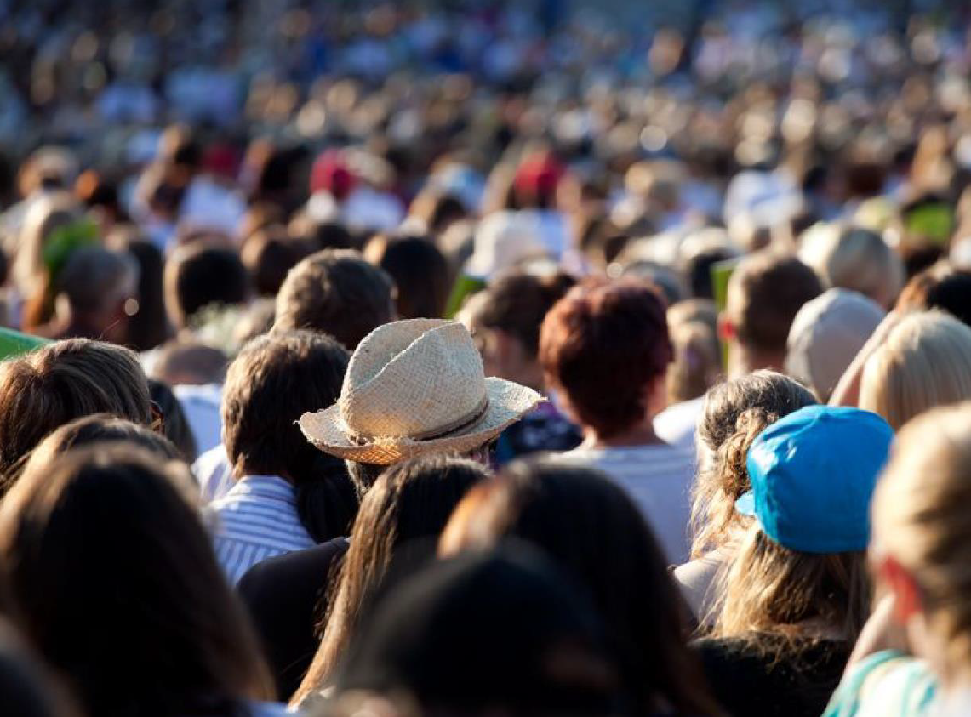

Slide 20
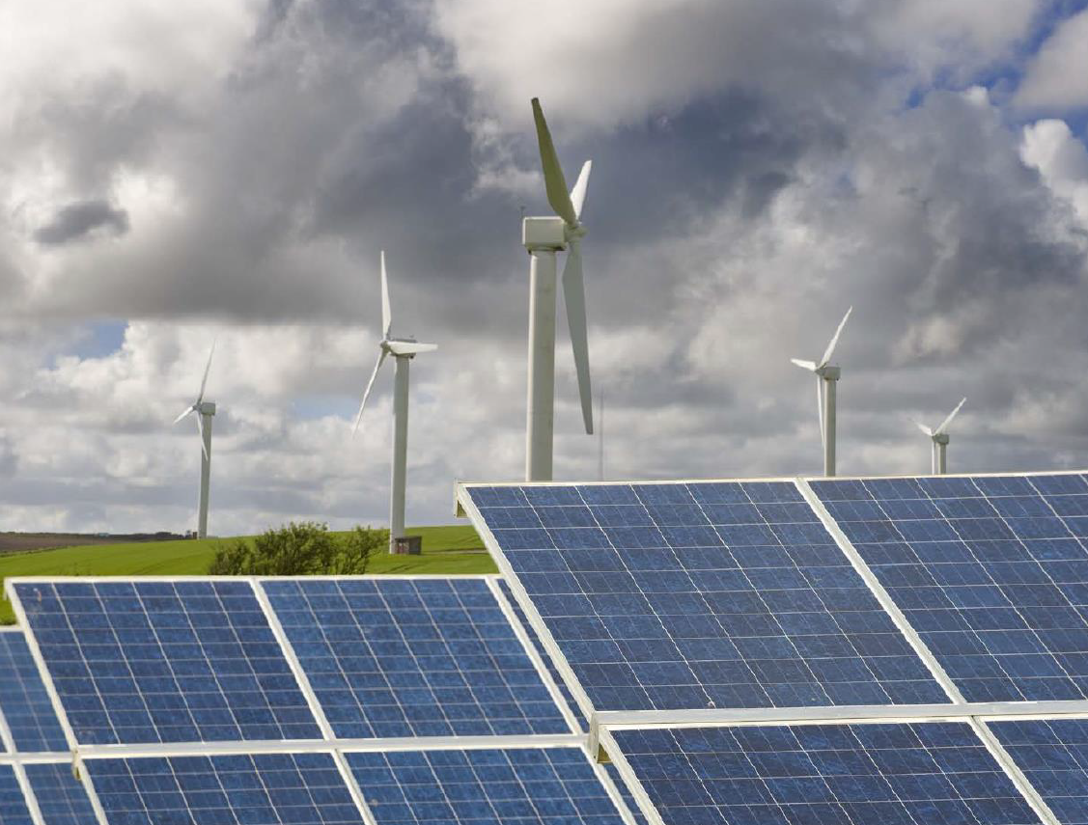

Slide 21
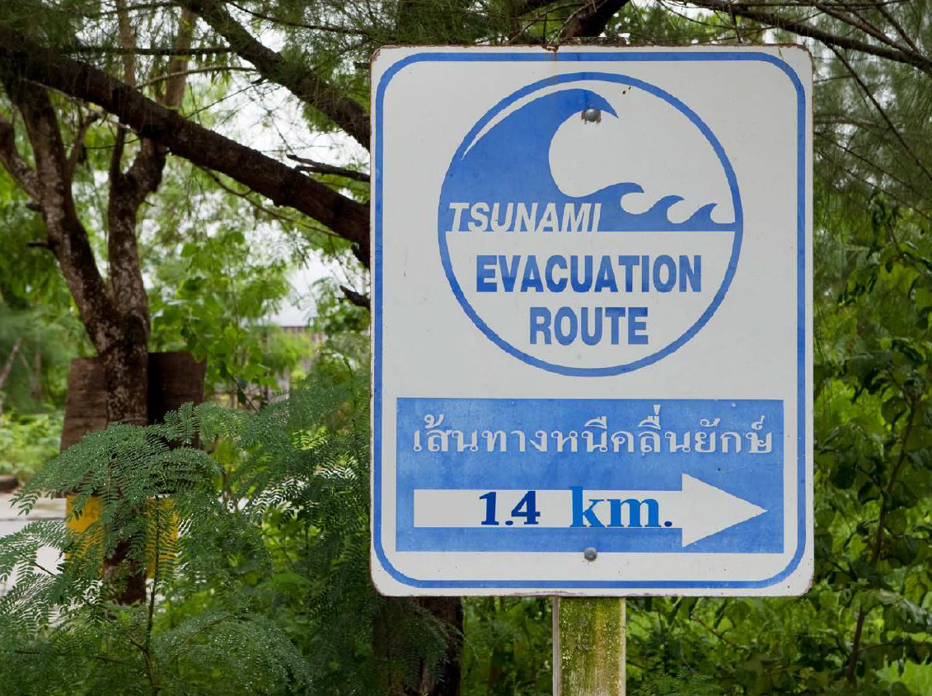

Slide 22
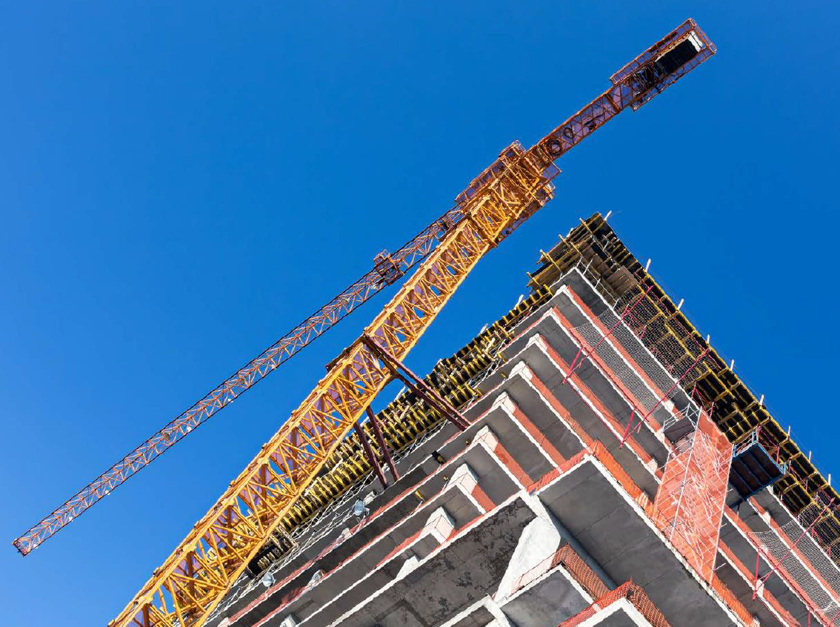

Slide 23
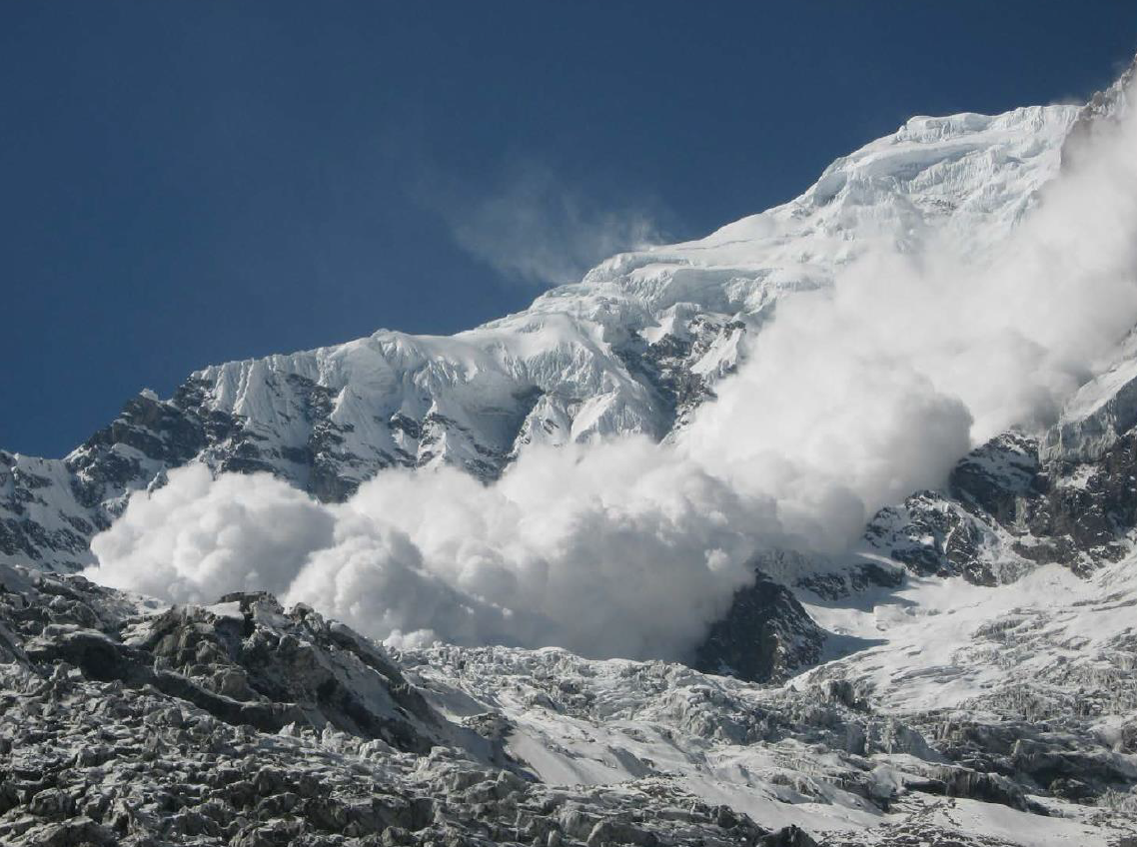

Slide 24
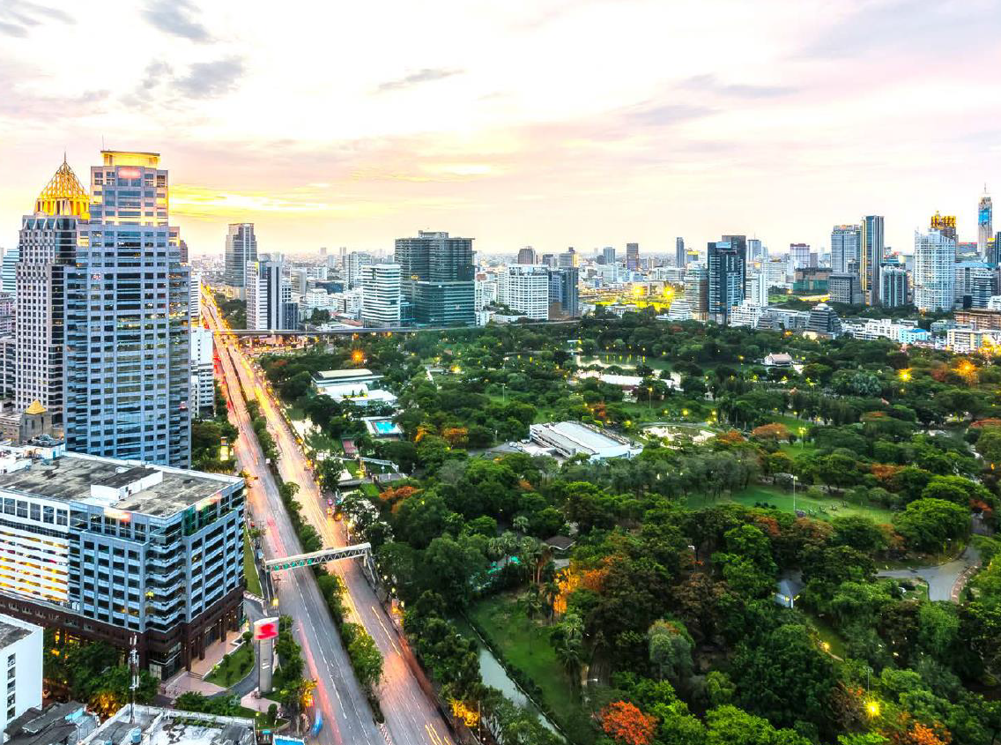

Slide 25
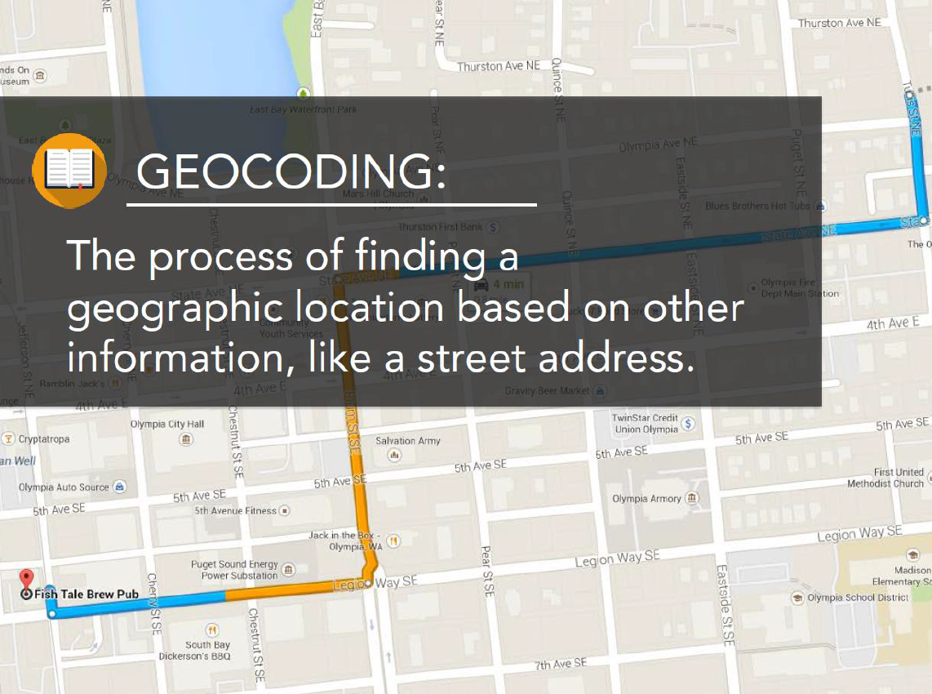

Slide 26
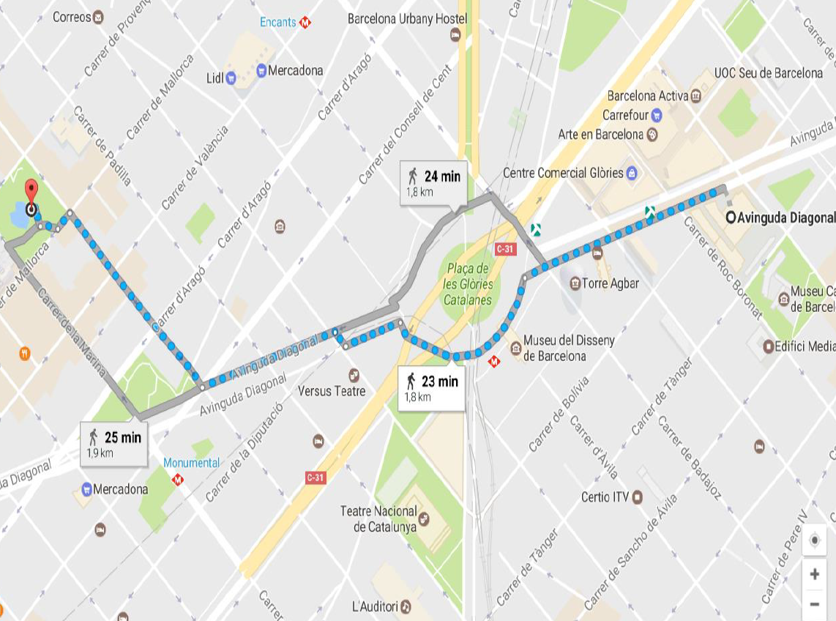

Slide 27
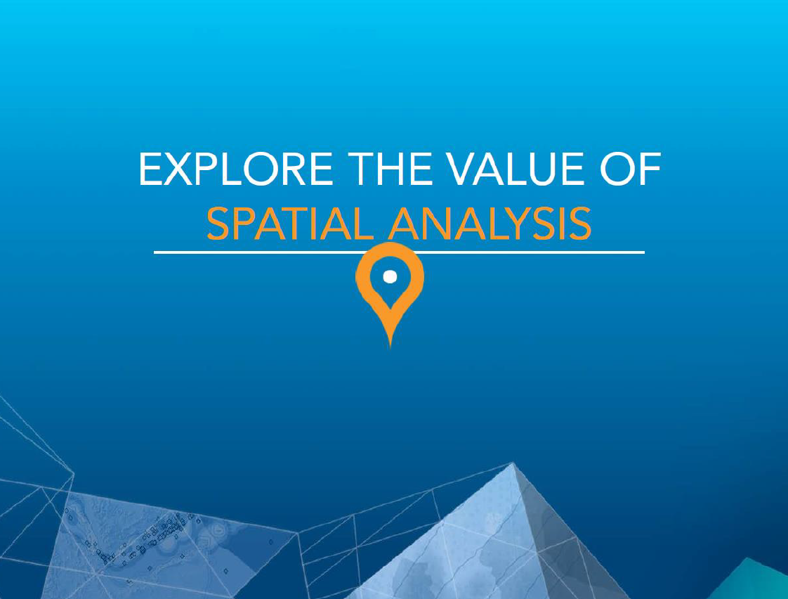

Slide 28
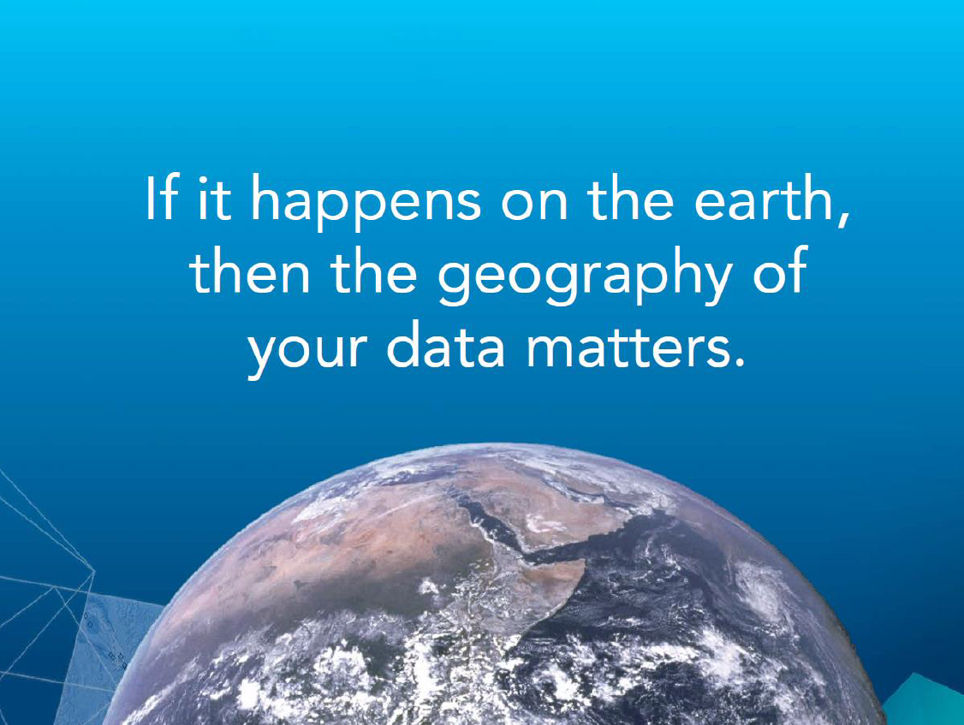

Slide 29
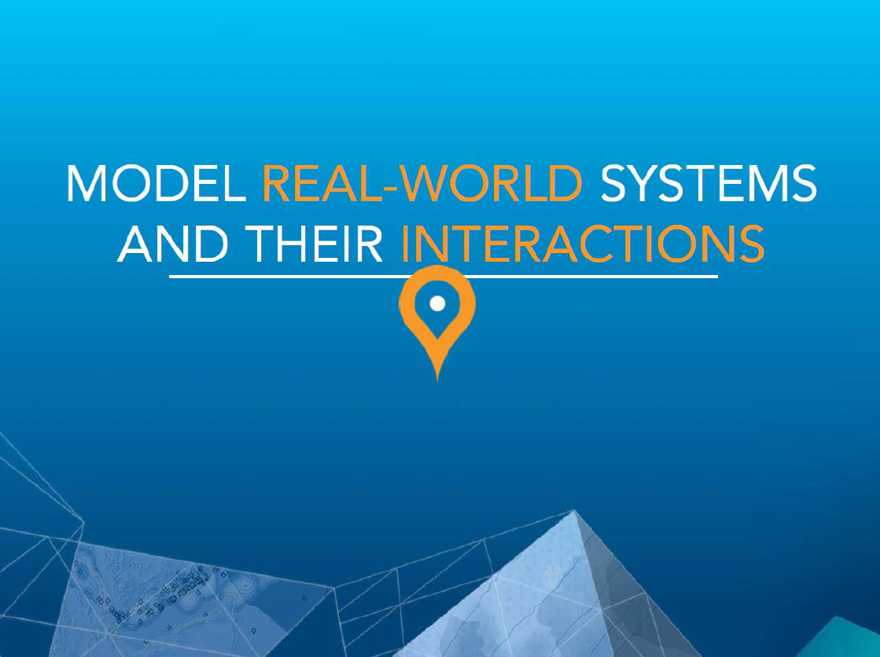

Slide 30
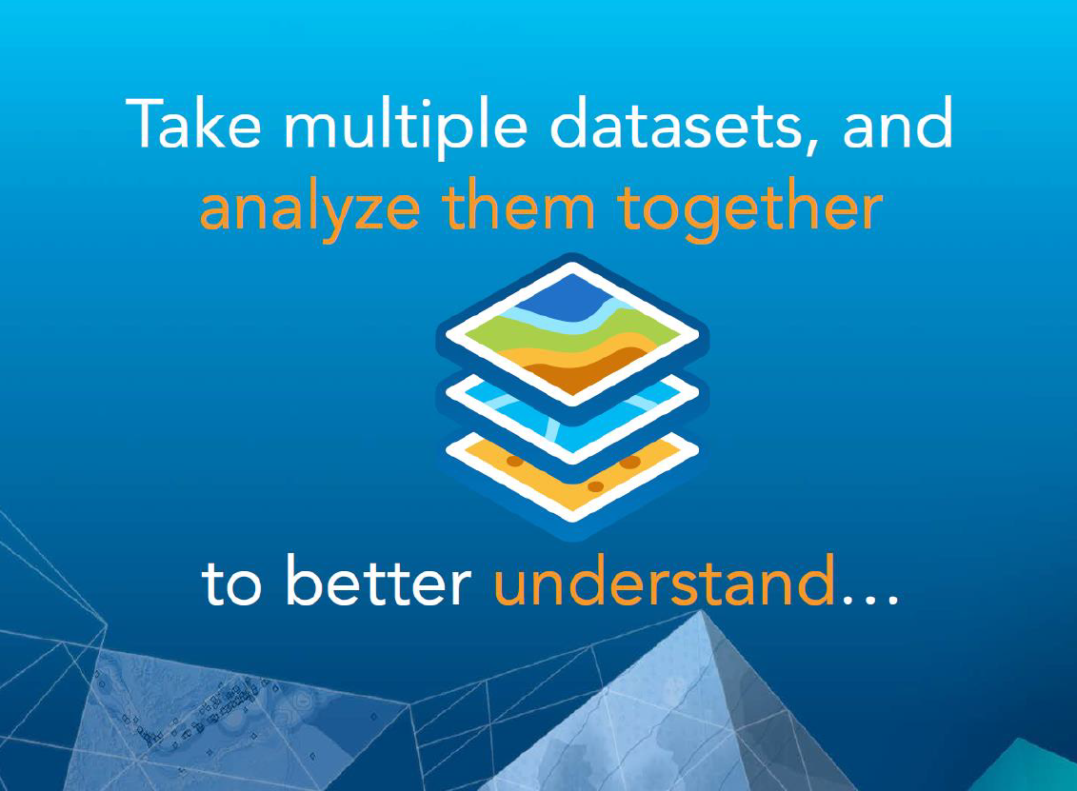

Slide 31
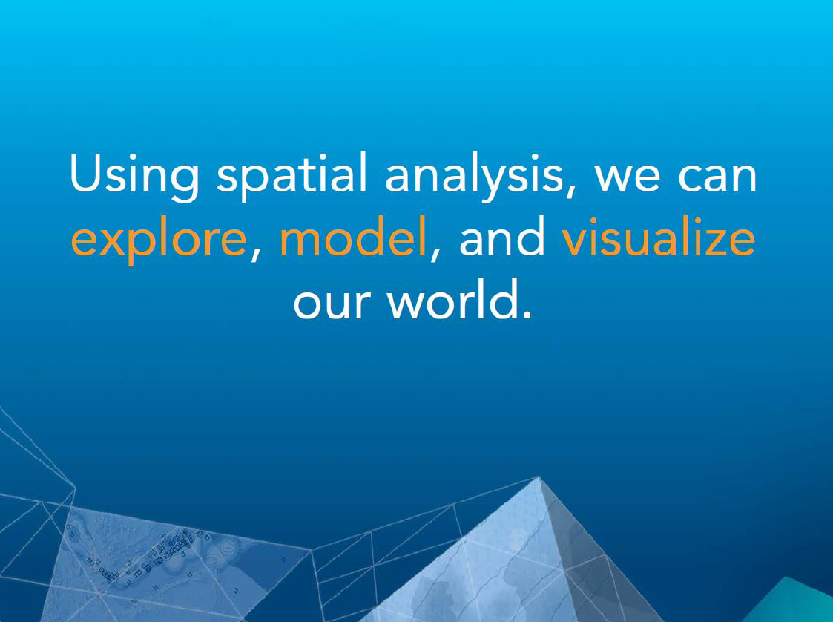

Slide 32
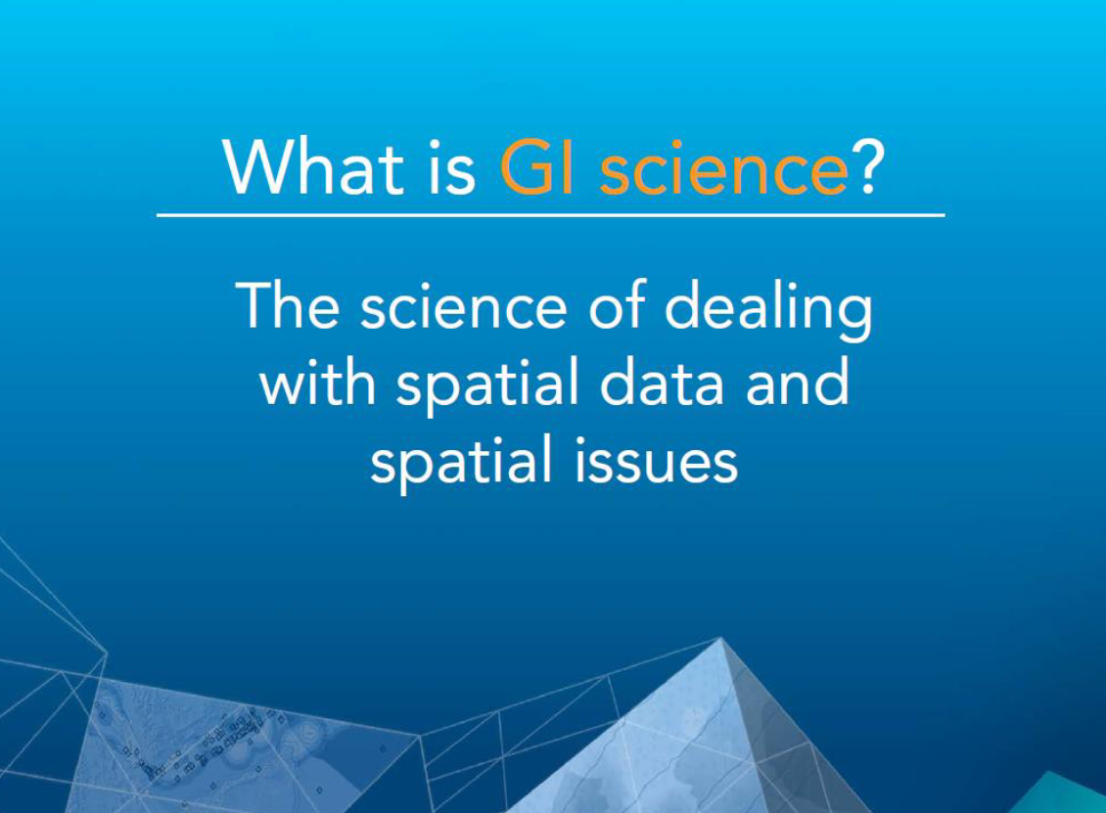

Slide 33
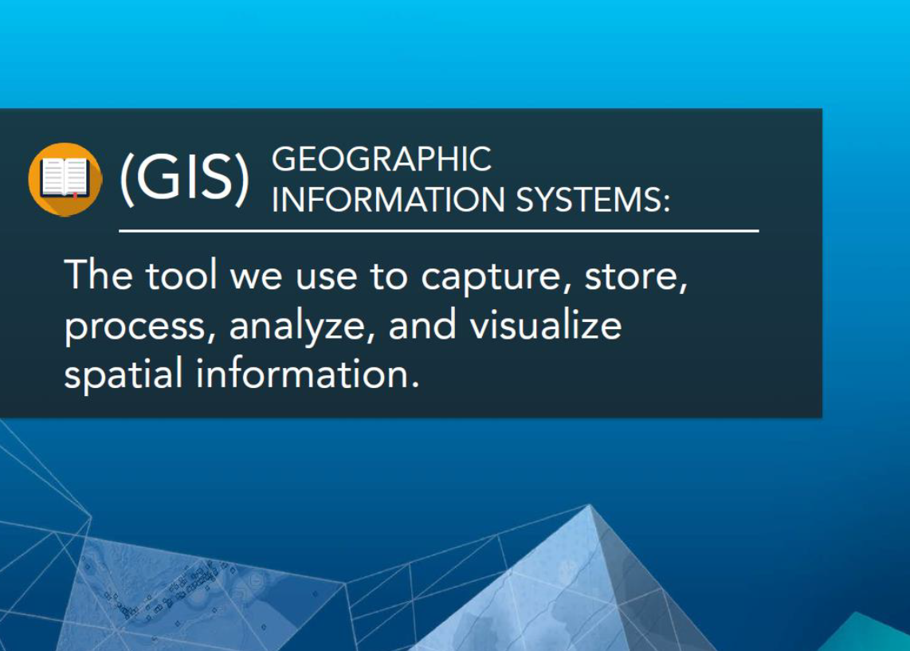

Slide 34
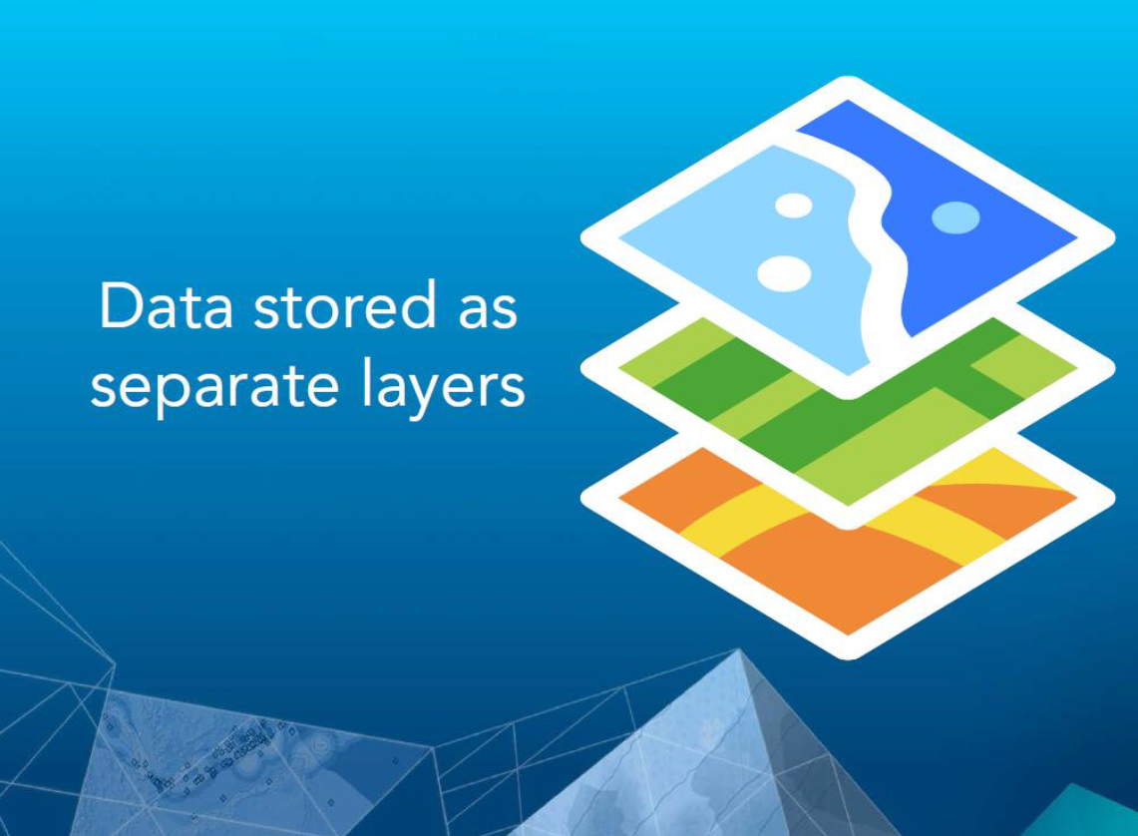

Slide 35
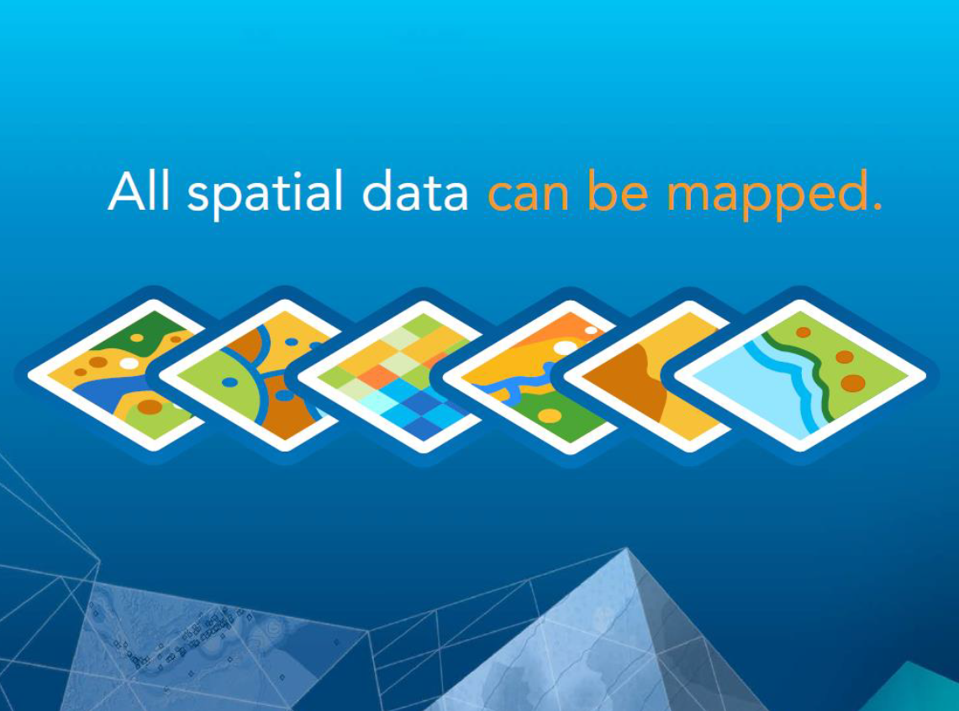

Slide 36
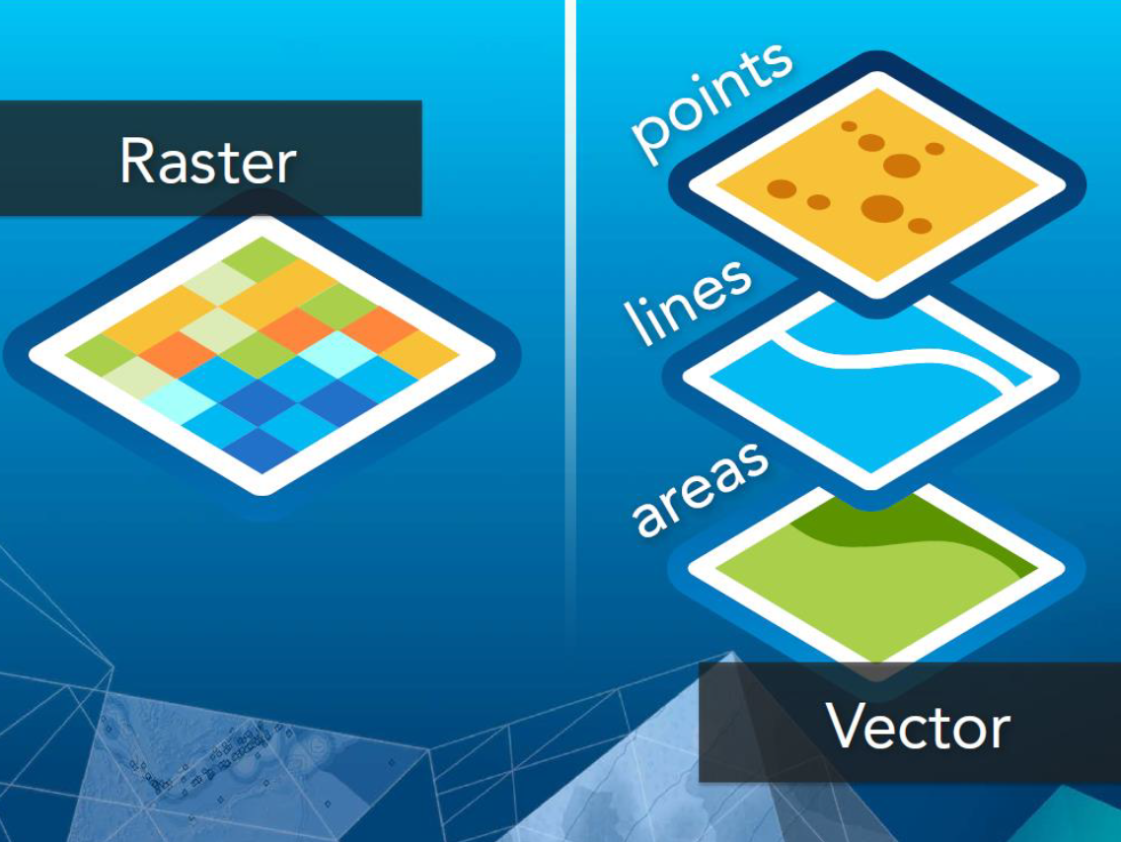

Slide 37
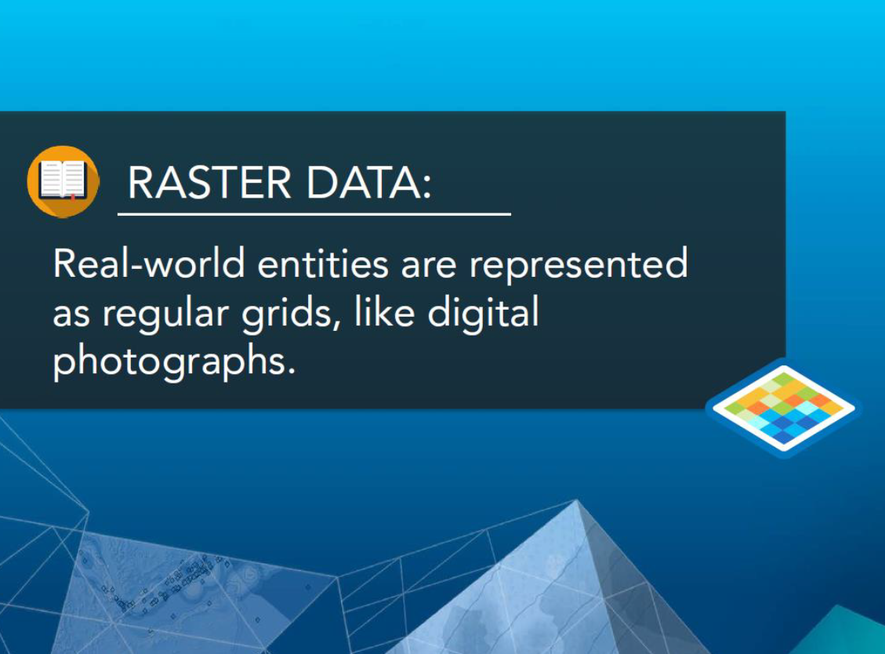

Slide 38
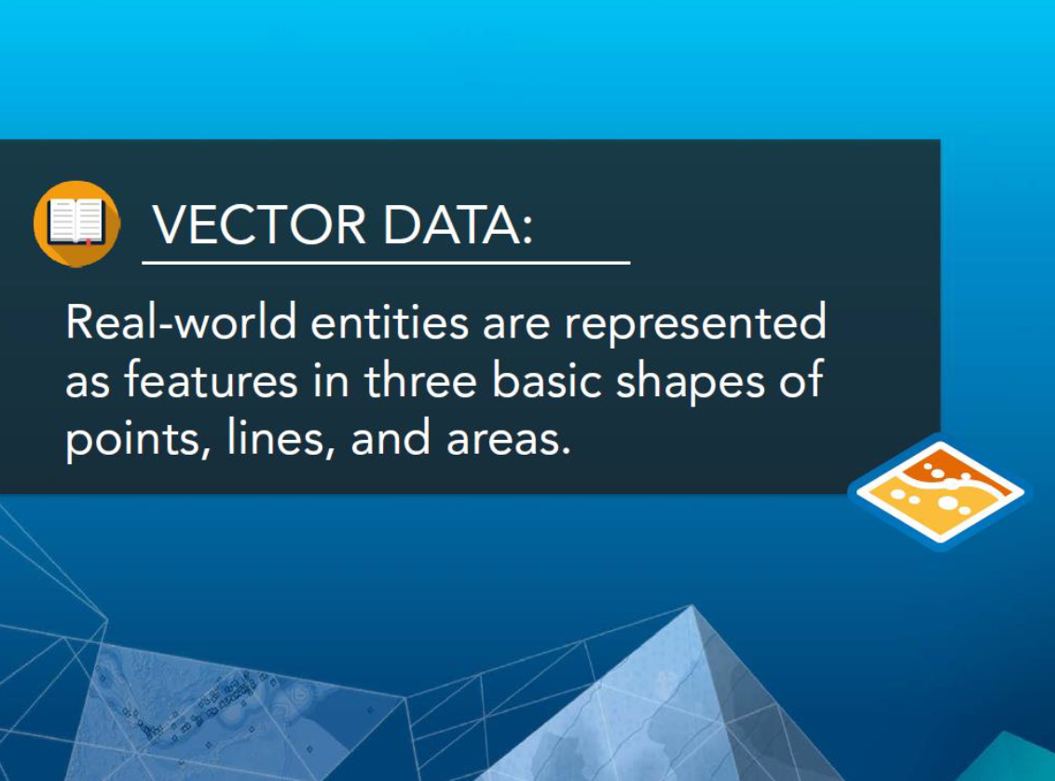

Slide 39
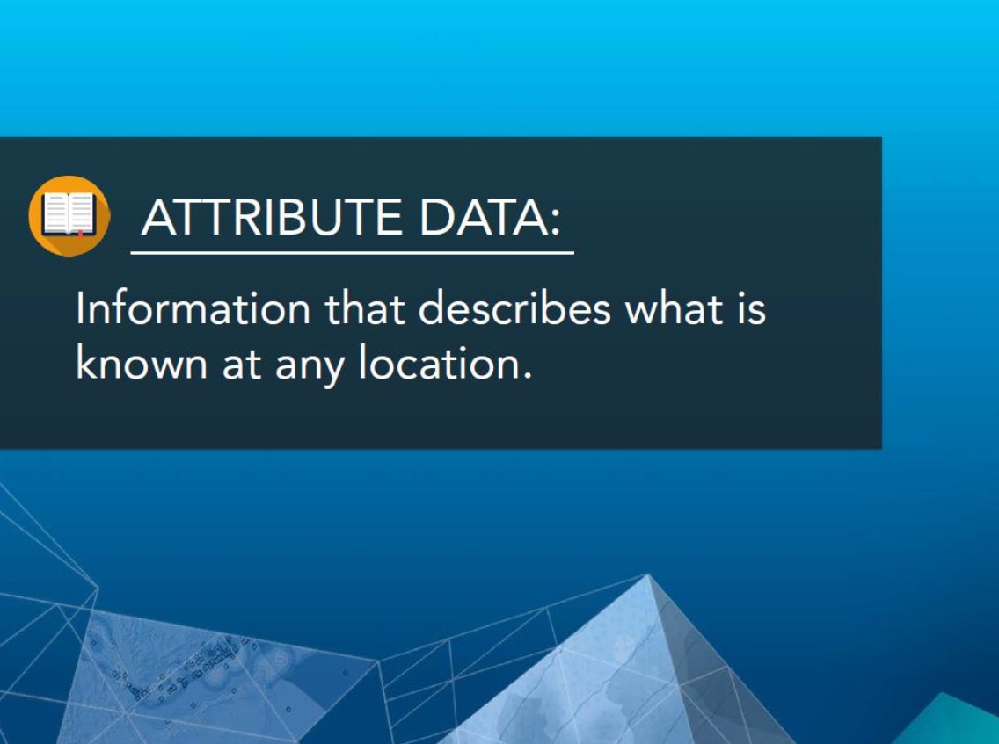

Slide 40
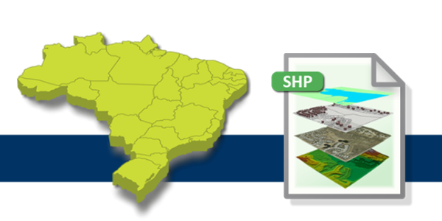
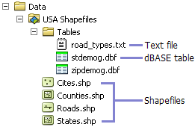
Shapefile (Shp) – popular geospatial vector data format for GIS software. http://wiki.openstreetmap.org/wiki/Shapefiles
Each shapefile contains:
Shapefile shape format (.shp)
Shapefile shape index format (.shx)
Shapefile attribute format (.dbf)
Shapefile spatial index format (.sbn)
Shapefile Projections Definition file (.prj)

Slide 41
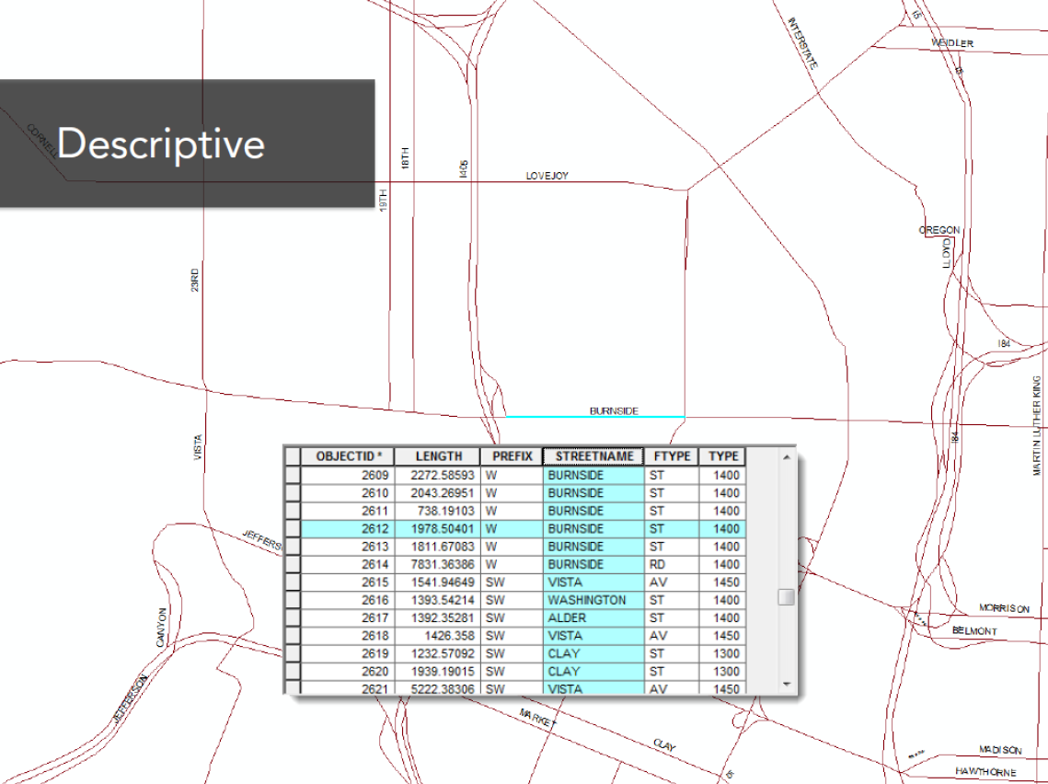

Slide 42
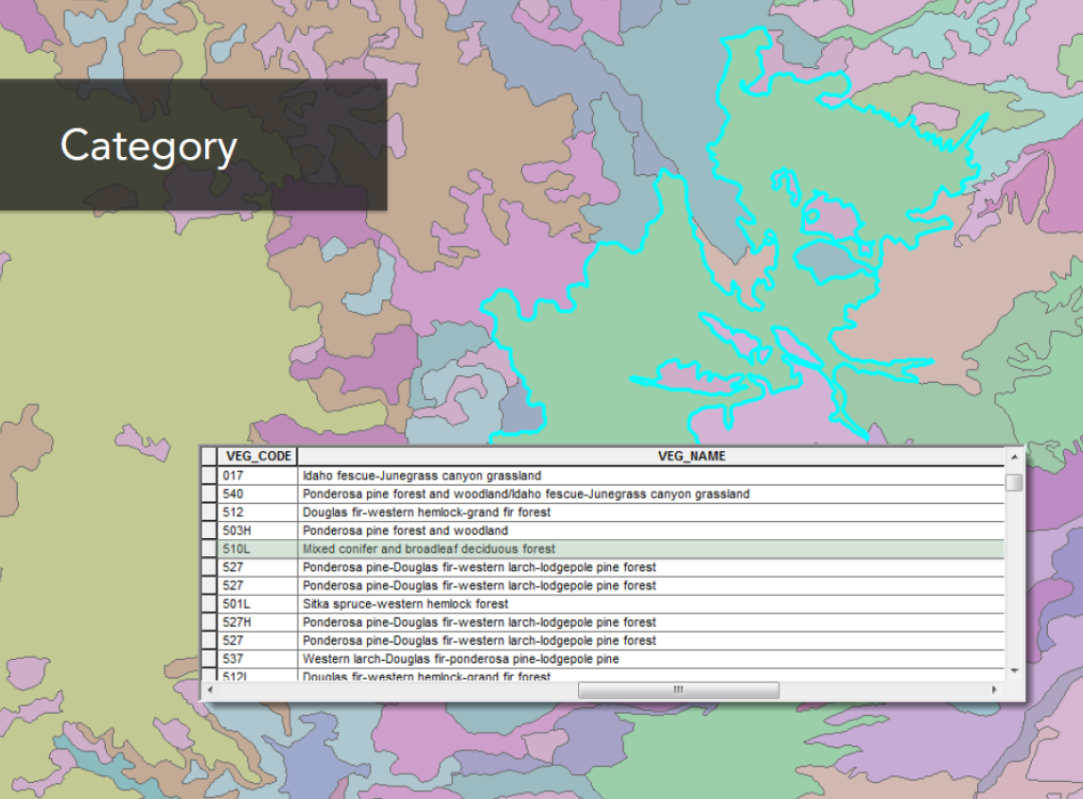

Slide 43
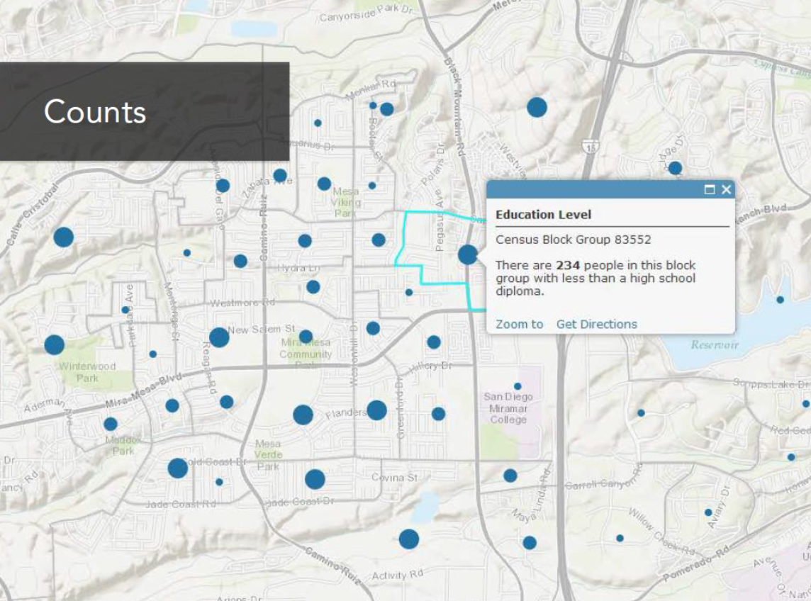

Slide 44
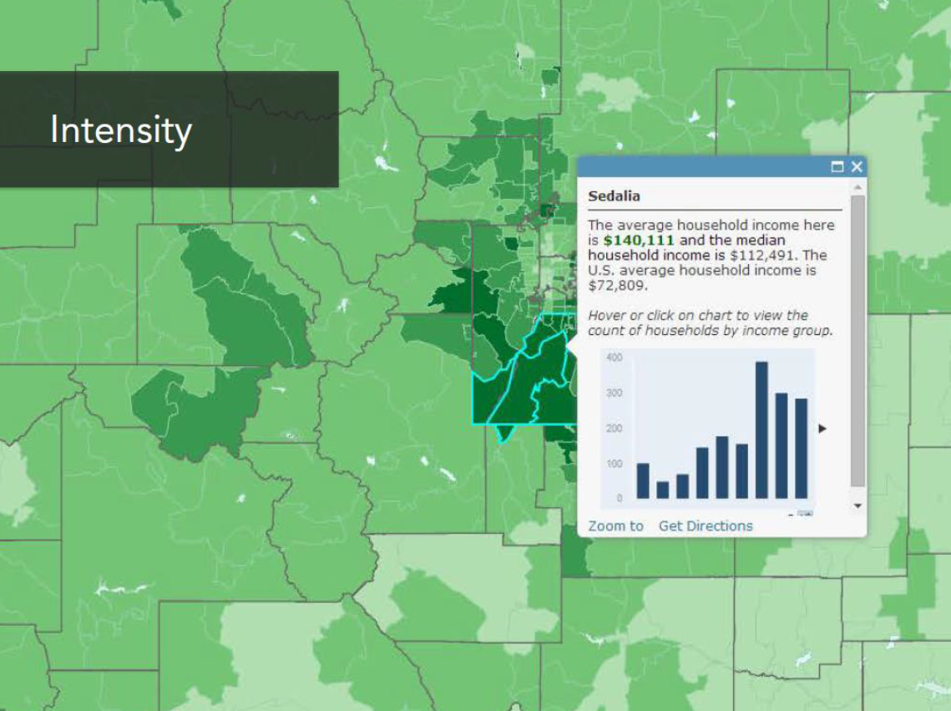

Slide 45
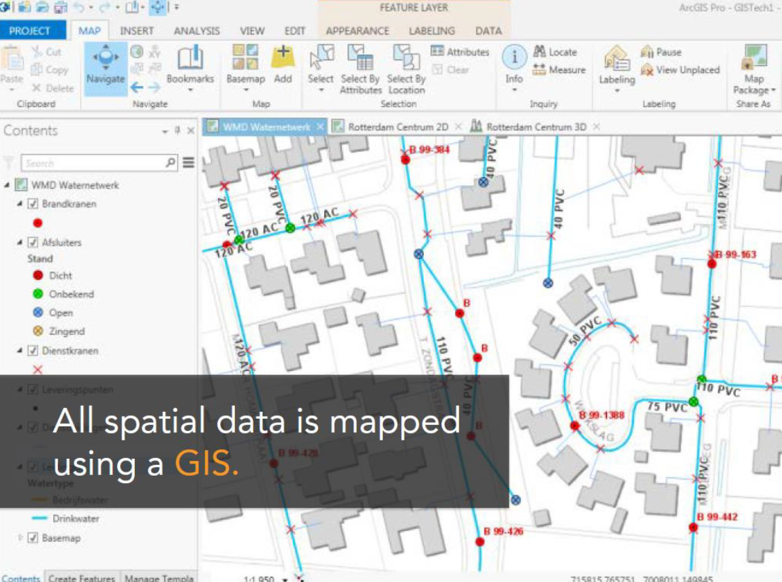


Slide 46
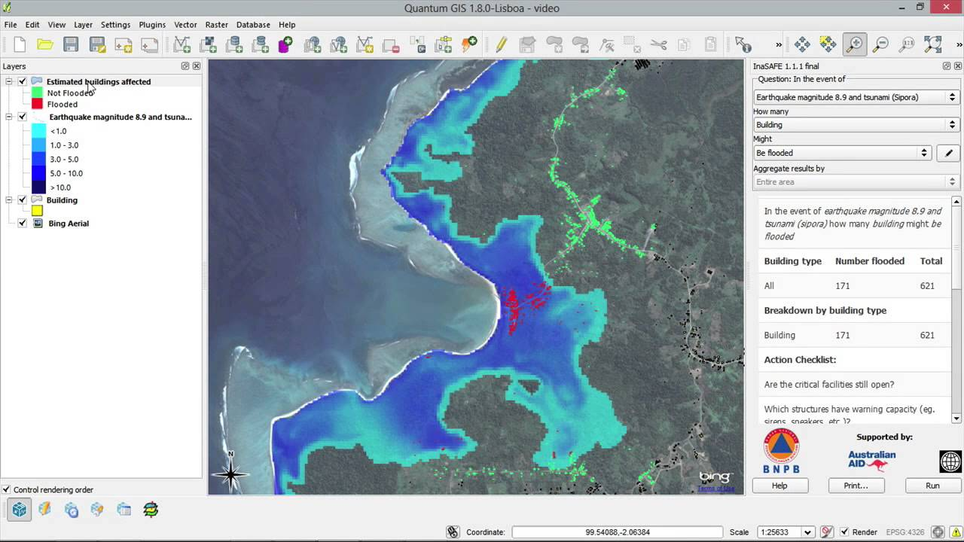

QuantumGIS software (Windows and Mac): http://www.qgis.org/en/site/forusers/download.html

Slide 47
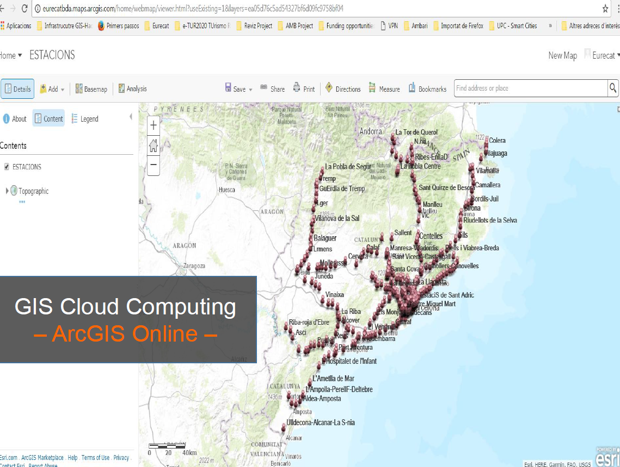

Slide 48
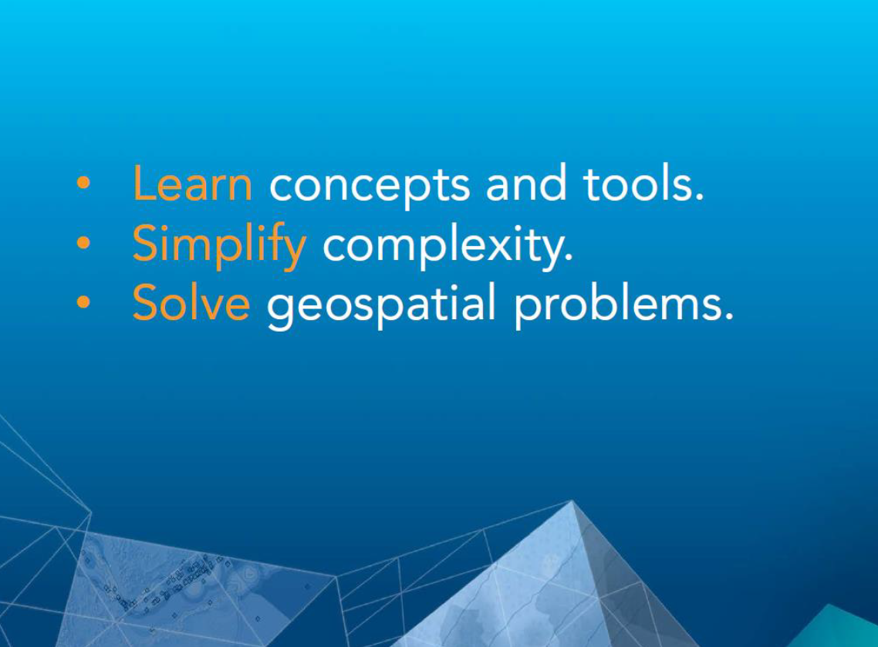

Slide 49
Contents
I. Activities in the class (Demo)
Creation of personal ArcGIS Online account.
Exploration of GIS data files(csv, text, shapefile and Web Map Service (WMS) and the ArcGIS Online framework.
Clone the Git repository to get an initial code:
https://github.com/FGutierresBTS/BTS_MasterInBigData.git

Slide 50
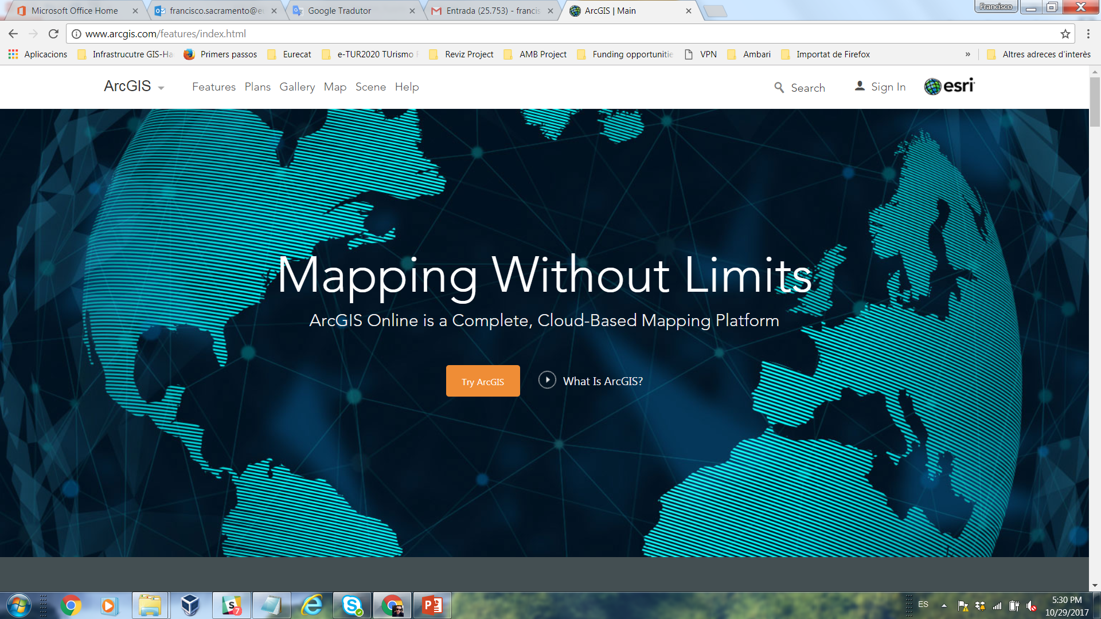
ArcGIS Online Account
http://www.arcgis.com

Slide 51
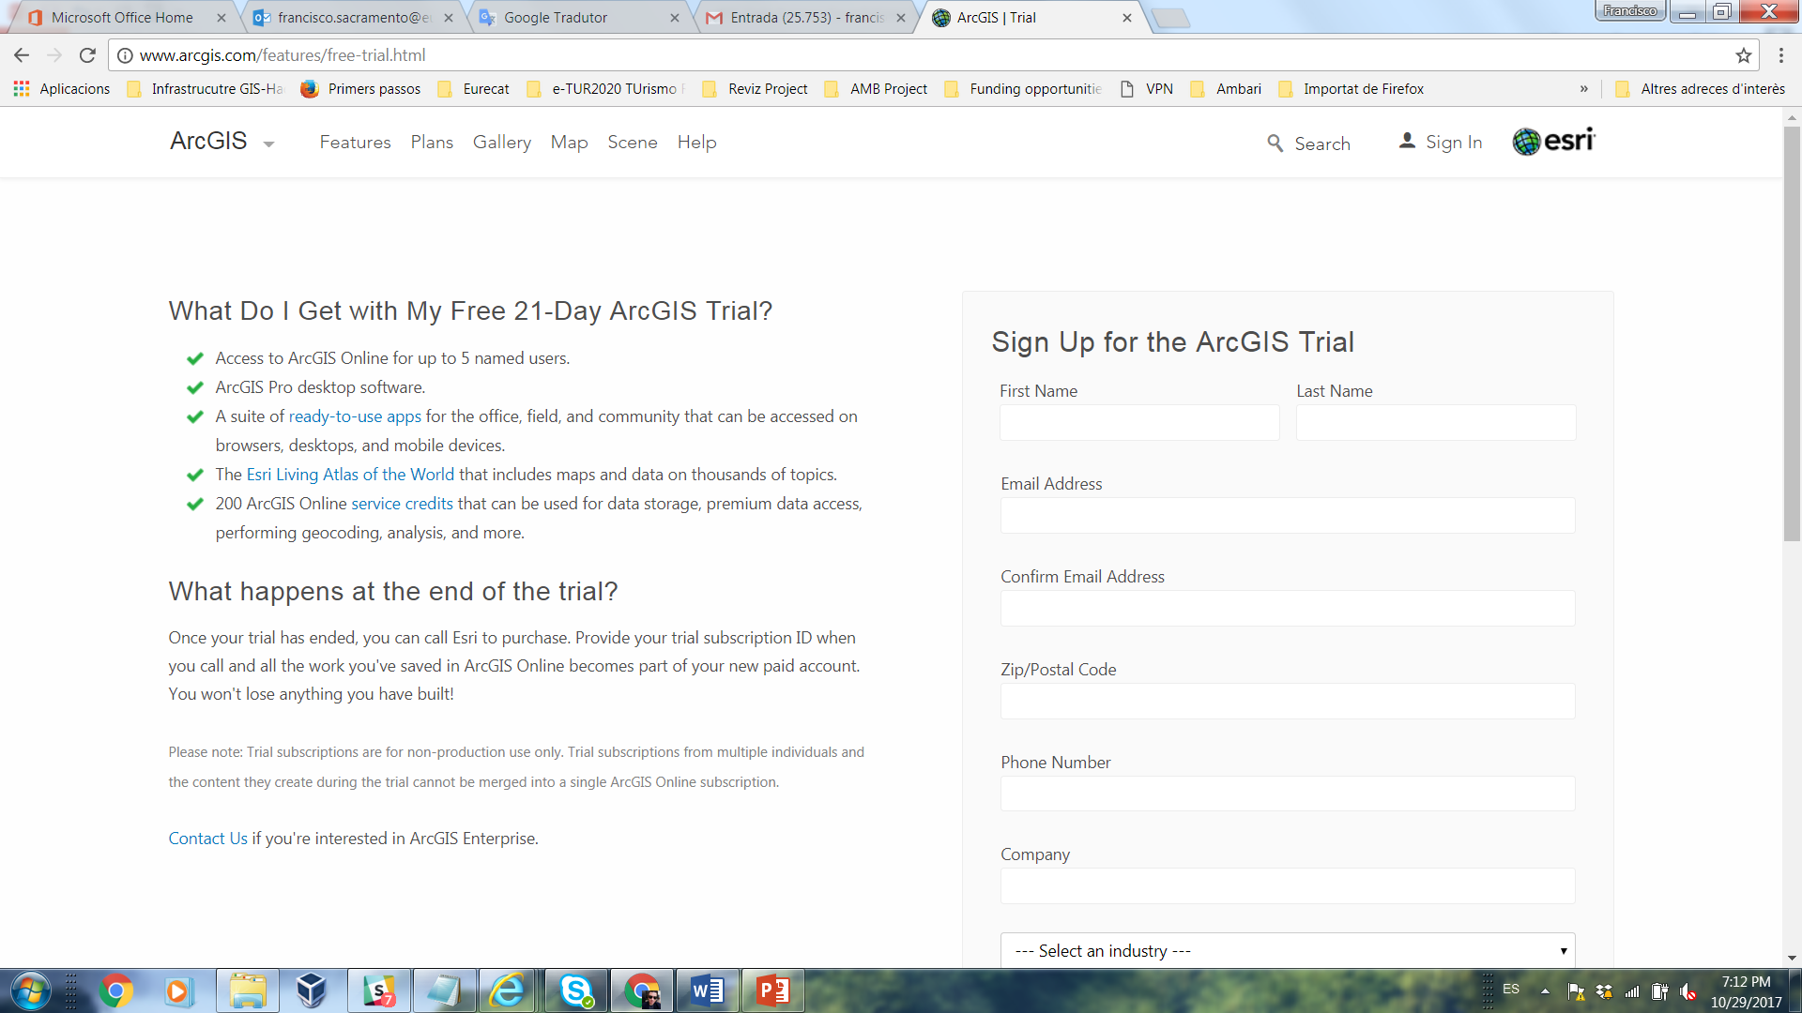
ArcGIS Online Account
http://www.arcgis.com

Slide 52
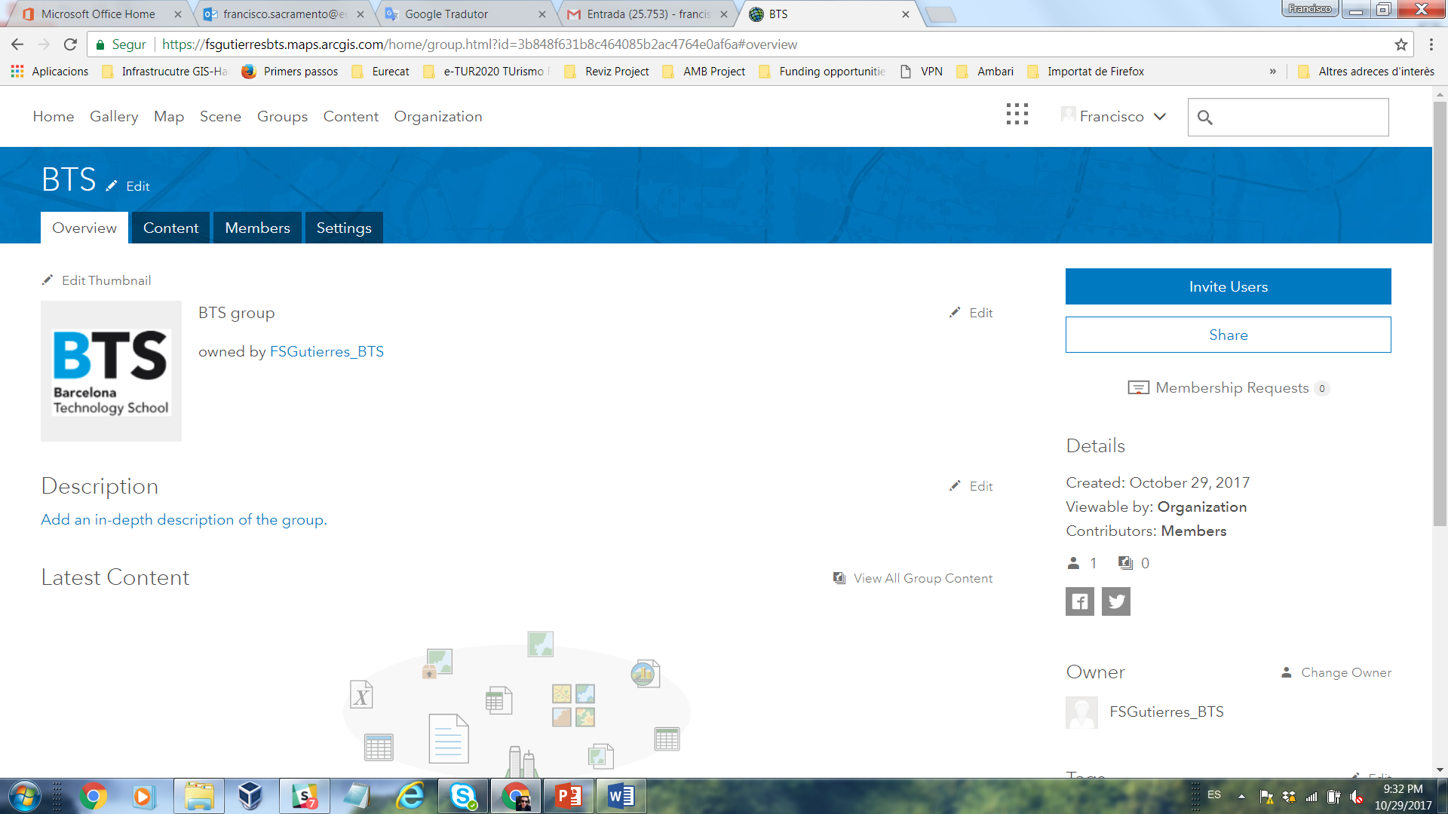
BTS Group

Slide 53

Thank you
Barcelona, 2017

